Slide 1

Riding Mechanic: An iOS App for Vehicle Monitoring and Analysis
Student Name: Dezheng Wang
Faculty Advisor: Dr. Elliott Forbes

Slide 2
Introduction
Difficult to imagine life without driving.
On-Board Diagnostic (OBD) applications
Disadvantages of OBD applications in the market
Advantages of Riding Mechanic

Slide 3
On-Board Diagnostic Systems (OBD)
Purpose of designing OBD
OBD-II
Unique features of OBD-II

Slide 4
OBD-II Scanner
How an OBD-II scanner works
Wi-Fi scanner and Bluetooth scanner
Reasons for choosing Wi-Fi scanner

Slide 5
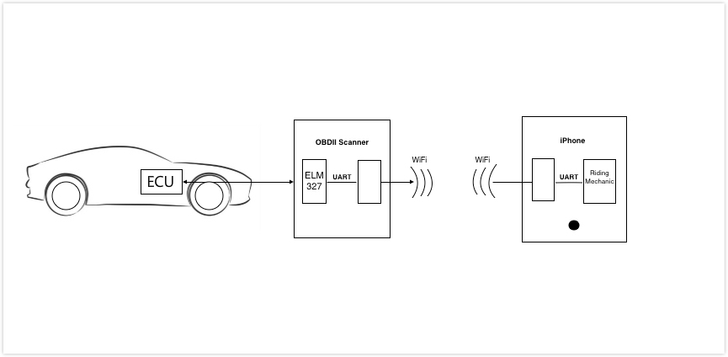
OBD-II Scanner
© Freelancer Technology Pty Limited

Slide 6
Onboard Diagnostic Parameter IDs
OBD-II PIDs
Ten modes
PIDs used in this project
Mode (hex) | Description
01 | Show current data
03 | Show stored Diagnostic Trouble Codes

Slide 7
PIDs Used in Project
OBD-II PIDs | Description
0100 | Get supported PIDs [01-20]
0120 | Get supported PIDs [21-40]
0140 | Get supported PIDs [41-60]
0105 | Get engine coolant temperature
010C | Get engine RPM
010D | Get vehicle speed
0110 | Get MAF air flow rate
0142 | Get control module voltage

Slide 8
Diagnostic Trouble Code (DTCs)
How characters are encoded
Consist of five characters
Each letter’s meaning
DTCs in this project
Letter | System
P | Powertrain (Includes engine, transmission, drive shafts, differentials and the Final Drive)
U | User Network (Wiring Bus or UART)
B | Body (Includes A/C and Air Bag)
C | Chassis (Includes ABS)

Slide 9
AT Command Set
Hayes command set
Compared to OBD-II commands
AT commands used in this project
Version | Command | Description | Group
1.0 | @1 | Display the device description | General
1.3 | @2 | Display the device identifier | General
1.3 | SP 00 | Set protocol to auto and save it | OBD
1.0 | Z | Reset all | General

Slide 10
Requirement Analysis
User requirements
Users want to do
Functional requirements
The system must have
Non-functional requirements
The system should have

Slide 11
A Simple Example
Index: Access.1
Name: Register
Purpose: To register an account for Riding Mechanic.
Input parameters: Username, password, confirm password
Action: Ensure that username doesn’t exist in the system.
Ensure that username is in email format.
Ensure that password or confirm password field should not be empty.
Ensure that password and confirm password are same.
Show information of registering an account successfully.
Output parameters: None
Exceptions: Username has already existed or username is not in email format
Password or confirm password is empty.
Password and confirm password are different.
Remarks: Application should show proper error message when users make mistakes.
Cross-references: None

Slide 12
System Architecture
Goal
Prototype: Incremental model
Identify Key technical risks
Constrains
OBD-II Wi-Fi scanner
Can’t connect to the server

Slide 13
Key Scenarios
Download and upload user information
Connect to scanner’s Wi-Fi
Keep sending OBD-II PIDs
Save trip information
Search trip information
Download and upload trip information

Slide 14
Application Overview
Application Overview
Combination architecture styles: client/server, object-oriented
Tools and programming languages for server and client

Slide 15
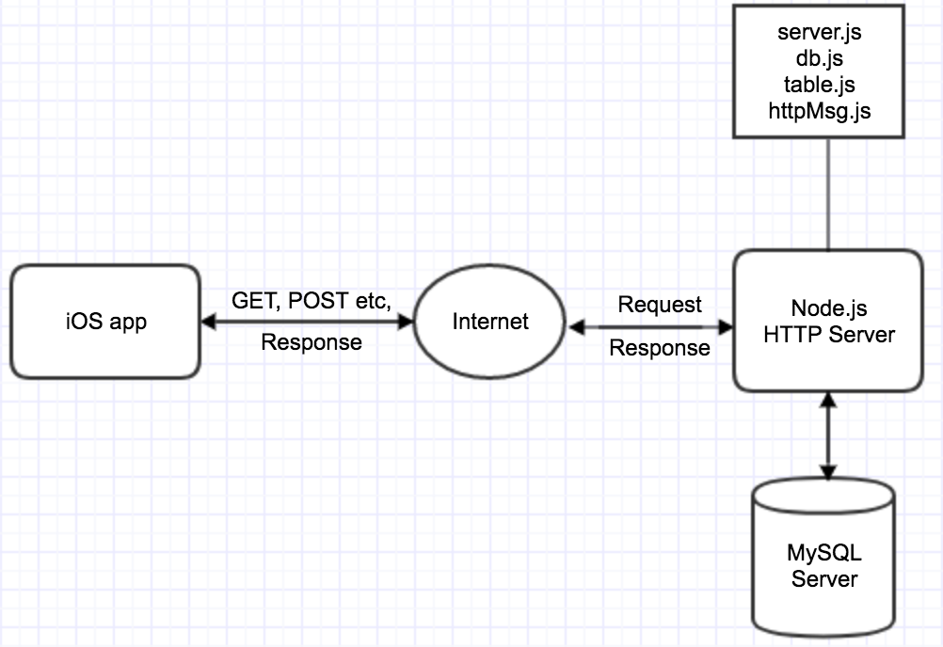
High Level Architecture

Slide 16
Key Issues and Solutions
Thread safety (UI, other activities)
Extra data about the car

Slide 17
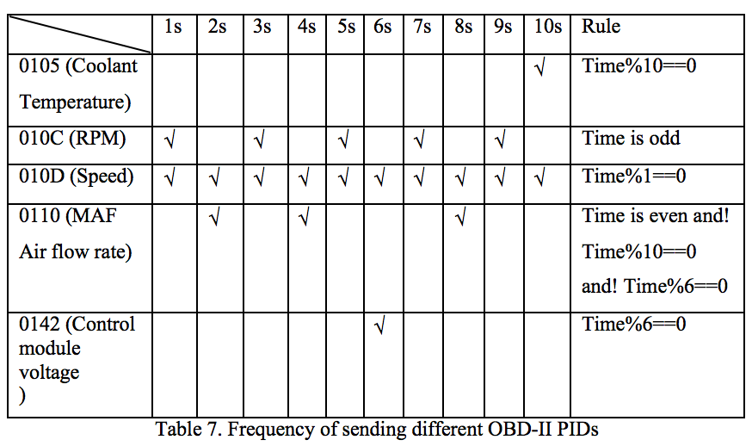
Frequency of Sending Different OBD-II PIDs

Slide 18
Key Values
How distance was calculated
How fuel cost was calculated
How sharp acceleration times and sharp braking times were calculated

Slide 19
Detailed System Design
Database design
User table
Trip table
Relationship between user table and trip table
Password encryption and decryption

Slide 20
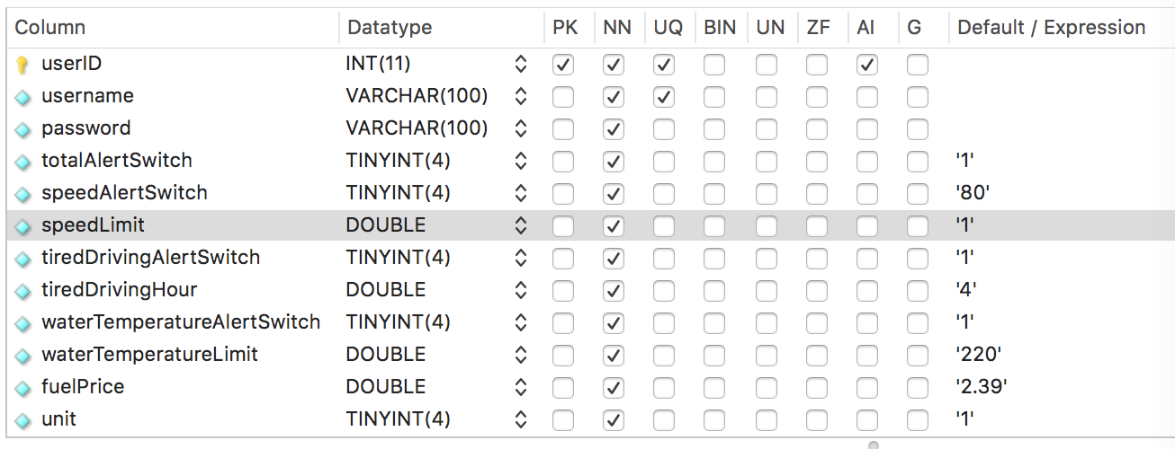
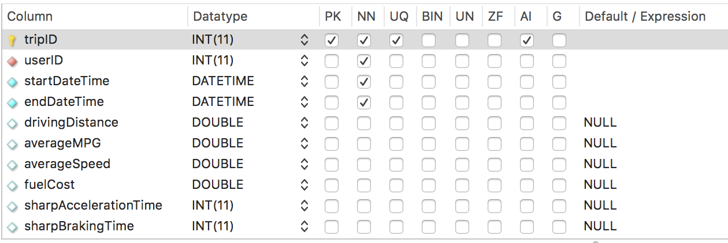

Slide 21
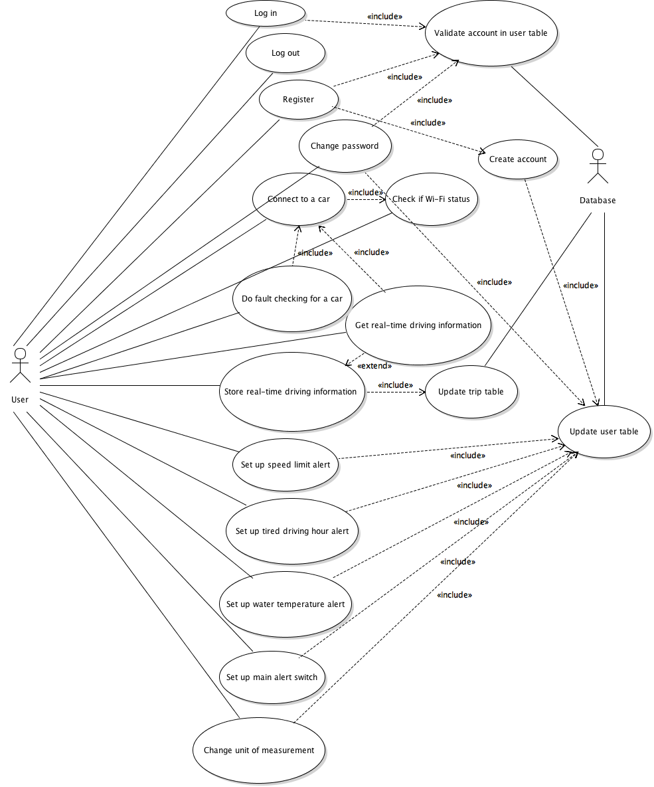
Use Case Diagram

Slide 22
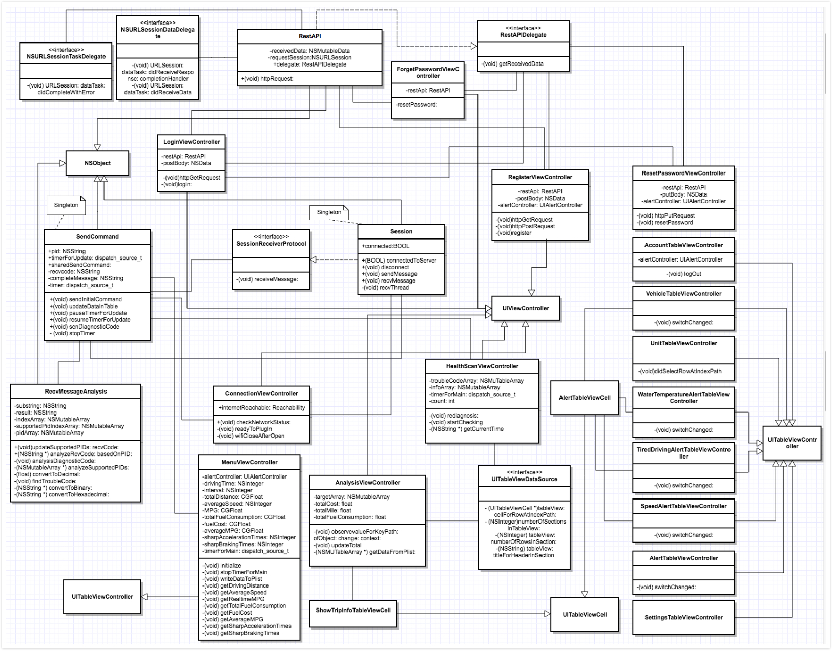
Class Diagram

Slide 23
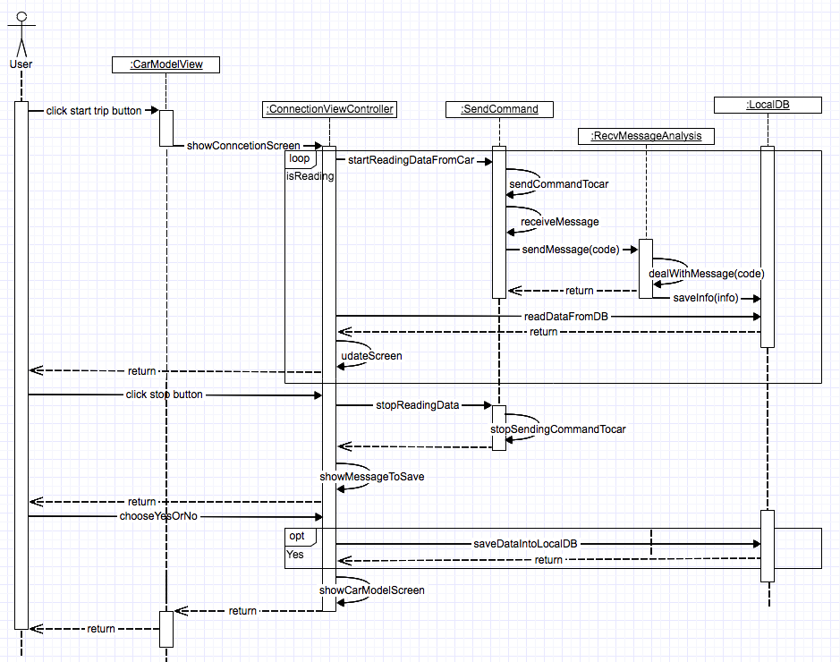
Sequence Diagram

Slide 24
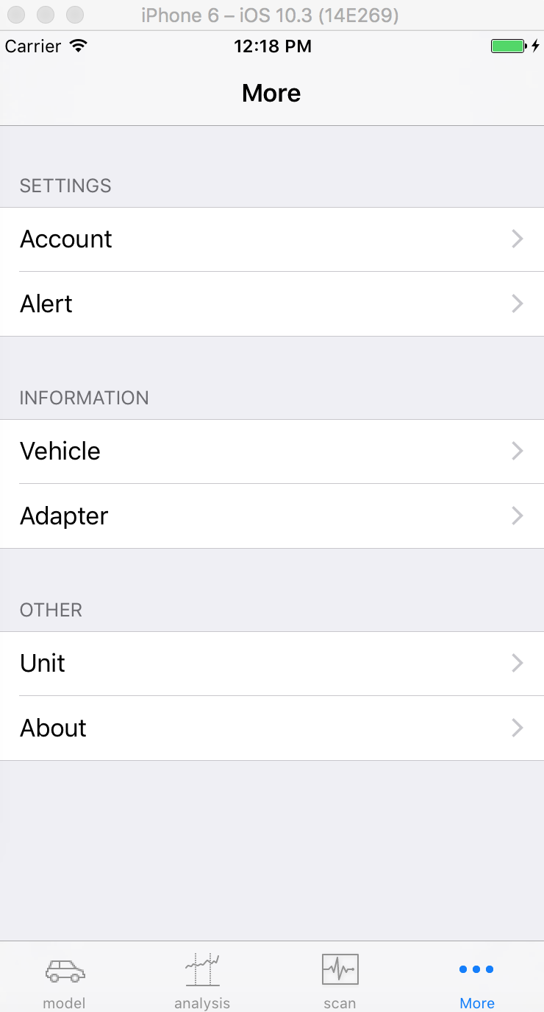
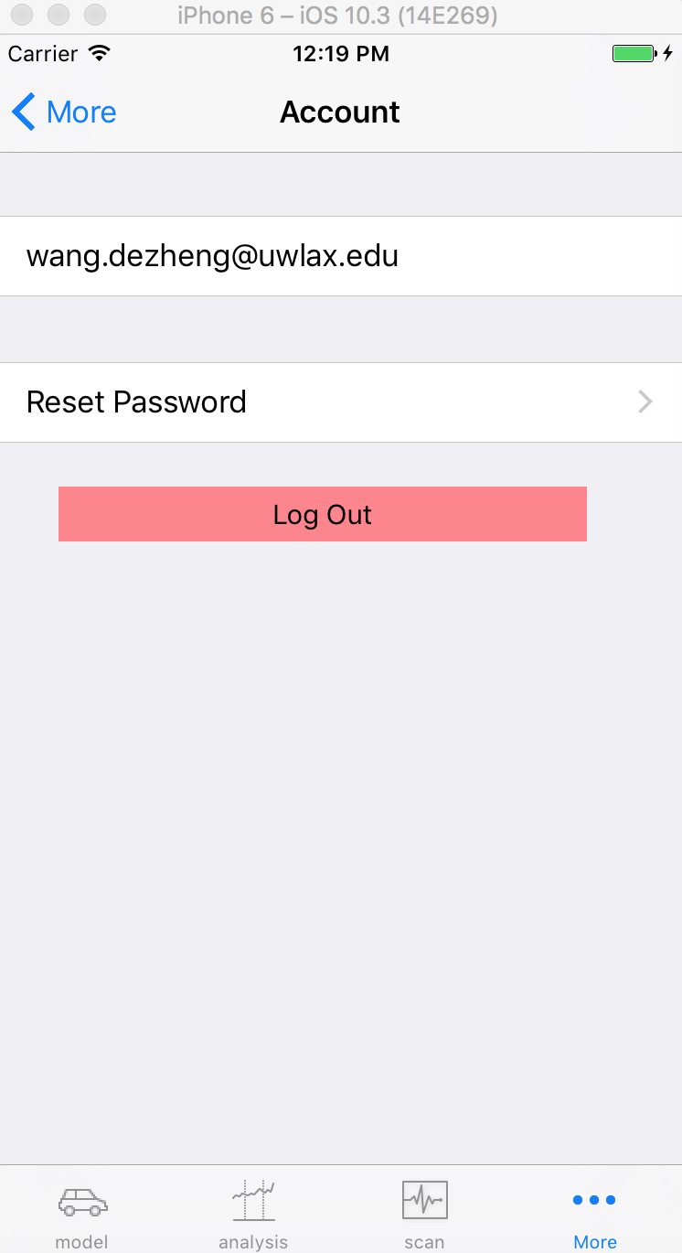
GUI Design
User Interface design
Tab bar
Navigation bar
Table view
Alert

Slide 25
Testing
Testing plan
Server side, Postman
Client side
UI testing in Xcode

Slide 26
Example
Test case # | Scenario | URL | Return value | Status
1 | User table has this account | 138.49.101.87:9000/userSettings /wang.dezheng@uwlax.edu Method: GET | All user information related to username ‘wang.dezheng@uwlax.edu’ | Passed
2 | User table doesn’t have this account | 138.49.101.87:9000/userSettings /wang.dezheng@uwlax.edu Method: GET | [] | Passed

Slide 27
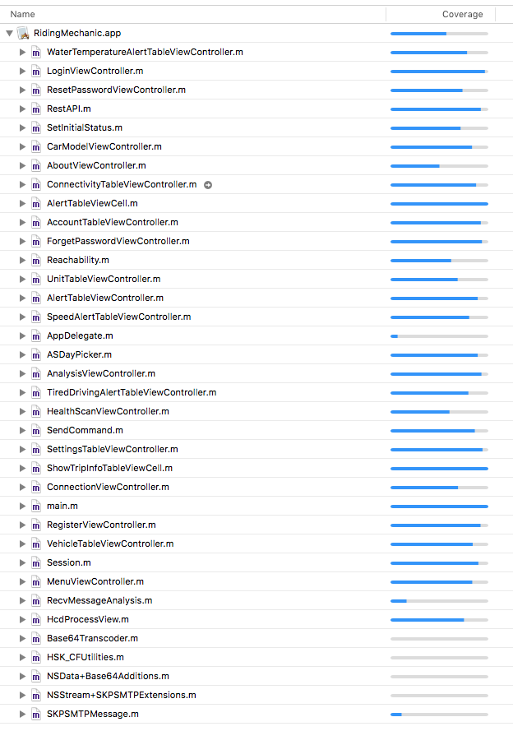
Code Coverage

Slide 28
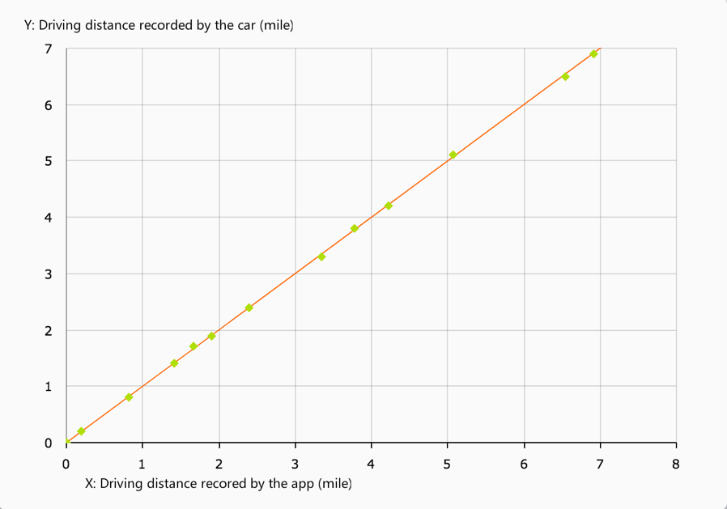
Comparison

Slide 29
Conclusion
Conclusion
Achievement
Defects
Future Work

Slide 30
Demo
Register, login, reset password
Start a trip, read real-time data, record a trip
Set speed alert, start a trip, record a trip
Search trip information
Read diagnostic trouble codes form the car

